Slide 1
Restaurants/Cafe/Pub- Info & Reviews Group 4 Kasey Eljoundi, Sai Kiran Mankena, Varchasvi Verma, Amulya Kamshetty, Jasleen Arora, Pooja Reddy Nathala 14 April, 2017

Slide 2
Project definition & Scope of Work
The scope of project is to create a user interface application that allows users to search for a restaurant/cafe/pub in Charlotte, look for reviews and other related information, add reviews. This Application would also allow business owners to list their business and provide more details on their services and facilities.
Our scope of work is using a database that contains all the information regarding the restaurants in Charlotte that customer would like to know including name, address, zip code, neighborhood, cuisine, ratings, reviews, contact info etc. We will create user specific & restaurant specific logins so that users can browse, add and modify reviews. Restaurants/Cafe/Pub can update their information on application if required via admin. We would also incorporate retrieve and delete feature to keep database up-to-date.
This web-application will provide all the information of Restaurants/Cafe/Pub on a single platform and will give user access to rate & review.

Slide 3
Business Rules
An admin can manage one to many businesses.
A business can have one to many locations.
A business can be in one or more categories (Restaurant, Cafe, Pub, Brewery, etc.)
A business can serve one and only one cuisine.
A person attribute should be defined using super-sub classification for user & admin and whether the participation is disjoint or overlapping should be indicated.A business can have 0 to many reviews.
A business can have many menu items.
A user can vote each review only once.
A business can be reviewed by multiple users. Also, a single user can review multiple businesses. Hence, many to many relationships.

Slide 4
Constraints
Concrete credentials for person user_id, email and password.
No two persons can have the same user_id.
A User can only vote a review either up or down
A User can give the review in the form of stars, or content or both.
Only the registered users can vote on or write the review.
A person who views the review can be notified of Registration.
Only the admin has full access to the system.
Only the registered user have the opportunity to delete or edit his review.

Slide 5
Constraints continued…
The view for other users review is user preference.
The system need to aggregate the ratings for an item in a business and provide an updated avg user rating for a particular item in a particular business.
A user can only write the review in English language and give the rating upto 5 stars.
The aggregate user rating will be notified to the admin for every month.

Slide 6
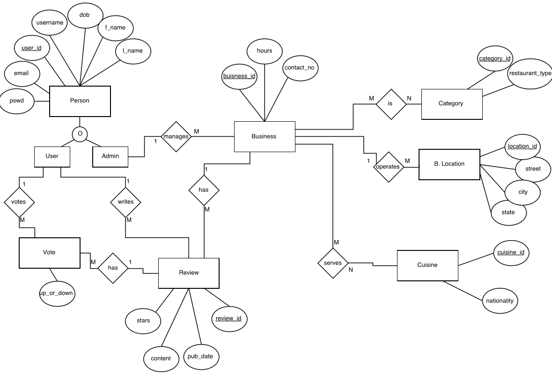
EER Diagram

Slide 7
EERD Narrative :
The EERD above depicts the Entity Relationships in the Restaurant/Cafe/Pub - Info & Review system. Every person in the system is stored in person table. A person can be User or Admin. Only Admin and User can login into the system. Type descriptor whether the participation is disjoint or overlapping should be indicated. Participation is between Admin and User is overlapping. An admin manages the business. Admin can add/update new business entry in the system. A Business can be either be a café/pub/restaurant or a combination of these categories. A business can have one to many locations. A business can serve one and only one cuisine and there can be many menu items for a business. One admin can manage one or many businesses. A business can have 0 to many reviews. When a user wants to vote or write a review, system makes an entry in the review table. A user can then vote or write a review for one or many businesses, and many users can write review or vote for one business. This many-to-many relationship is split into two one-to-many relationships using the Review & Vote tables.

Slide 8
Features:
Tables are in 3rd Normal Form.
Implementation of Generalization/Specialization:
General entity Person is specialized into 2 entities - User and Admin with overlapping discriminator.
Resolving Many to Many relationship using two one to many relationships:
The many to many relationship between User and Business entities is resolved by using Vote and Review entities, which has one to many relationships.

Slide 9
Tables
business
business_id | int(10)
business_name | varchar(45)
user_id | int(11)
hours | varchar(100)
contact_number | varchar (45)
cuisine
cuisine_id | int(10)
nationality | varchar(45)

Slide 10
Tables...
business_category_relation
business_id | int(10)
category_id | int(10)
business_cuisine_relation
business_id | int(10)
cuisine_id | int(10)
category
category_id | int(10)
restaurant_type | varchar(45)

Slide 11
Tables...
business_location
business_location_id | int(10)
business_id | int(11)
street | varchar(45)
city | varchar(45)
state | varchar(2)
zip | varchar(5)
vote
vote_id | int(10)
user_id | int(11)
review_id | int(11)
up_down | tinyint(1)

Slide 12
Tables...
person
user_id | int(10)
f_name | varchar(30)
l_name | varchar(30)
dob | date
username | varchar(20)
email | varchar(45)
password | varchar(200)
admin | tinyint(1)

Slide 13
Tables...
review
business_id | int(10)
review_id | int(10)
user_id | int(10)
content | longtext
published_date | datetime
stars | tinyint(1)

Slide 14
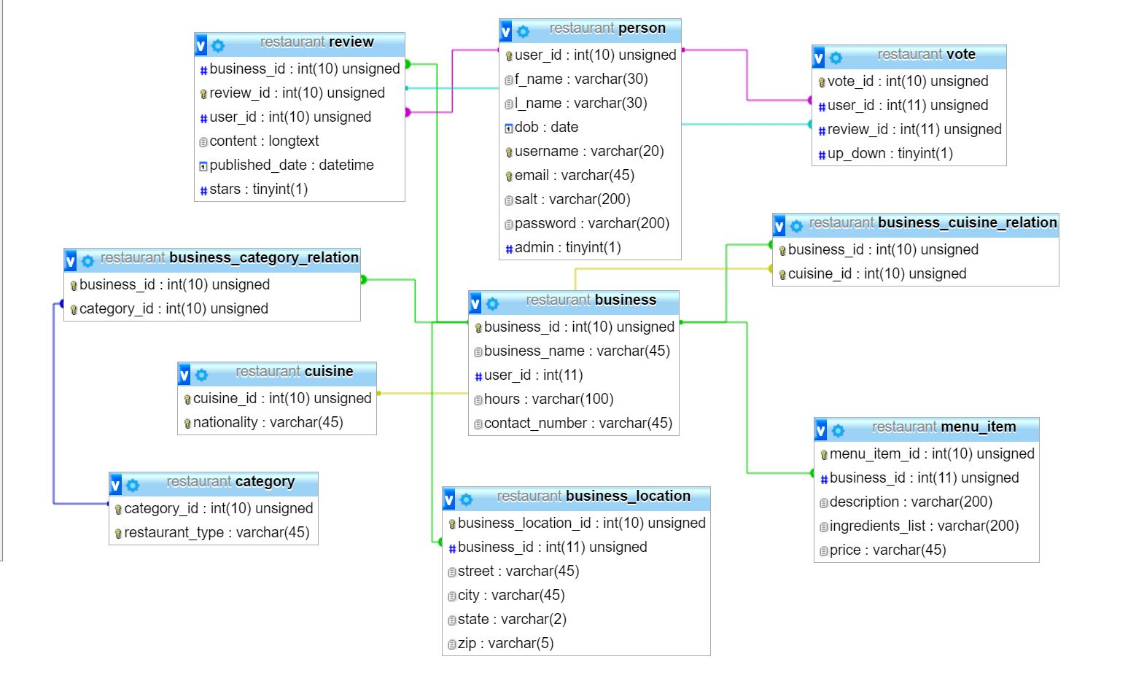
Relational Database

Slide 15
Implementation
The following are the languages confined within the system to enable development and implementation.
Apache web server to host the web application.
Cross platform browser to visit the web application.
Dreamweaver (IDE).
MySQL for database development, implementation and manage.
PHP for server side scripting
Html5 and the CSS to develop the front-end UI design and add style to the web page.

Slide 16
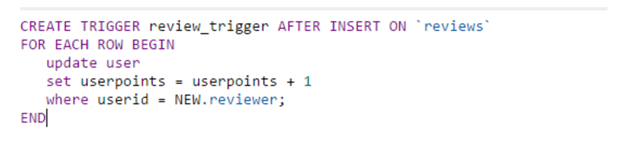
Add/ Update/ Delete operations
ADD:
Reviews are added when user visits a restaurant/Cafe.
New users are added in person table.
When a review is made, a new data will be added to the “reviews” table
DELETE:
Admin has right to delete businesses.

Slide 17
Future Scope of Work
Additional features:
Restaurants can add feedback on user review.
Restaurants can add their menu along with prices and ingredients.
User can make a reservation through the application.
Listing which of the restaurants provide order delivery or order pickup.
Security: Considering sensitive personal data related of the User, the database would implement measures that make the whole system secure.
Mobile App: The current system can be viewed on any Web Browser. But a stand-alone Mobile application would help access to the database system from mobile in a more efficient way.

Slide 18
Project plan
EERD creation and Decision on technology | March 31, 2017
Project Part I Report Submission | April 2, 2017
Database Implementation into SQL | April 8, 2017
Schema development | April 10, 2017
Project Part II Report Submission | April 16, 2017
GUI development & Integration | April 23, 2017
Testing & Final Checks | April 28, 2017
Project Part III Report Submission | April 30, 2017
Presentation | April 29, 2017

Slide 19
Team Contact Information
S.No. | Name | Email Address | Phone No.
1 | Kasey Eljoundi | keljound@uncc.edu | 704-819-6263
2 | Sai Kiran Mankena | smankena@uncc.edu | 704-756-3175
3 | Varchasvi Verma | vverma4@uncc.edu | 602-702-3889
4 | Amulya Kamshetty | akamshet@uncc.edu | 470-685-6557
5 | Jasleen Arora | jarora2@uncc.edu | 980-585-6185
6 | Pooja Reddy Nathala | pnathala@uncc.edu | 980-345-9321

Slide 20
Thank you

